Slide 1
How good is my industry? Managing ICT Energy
Mike Berners-Lee
Notes:
Section 1 : Setting the broader context

Slide 2
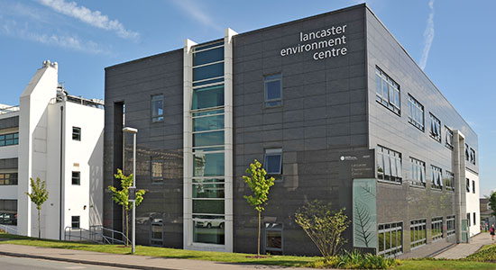

Slide 3
Global energy use
Notes:
Global energy use over time from 1850
As a species, our total energy use has been rising for millennia; almost every year we have used more energy than the year before
The rate of growth in energy use has also increased
Between 200 and 50 years ago, energy use rose at only around 1% per year
For the last 50 years or so, increase in global energy use has averaged at 2.4% per year
Energy growth, innovation and efficiency improvements have always gone hand in hand

Slide 4
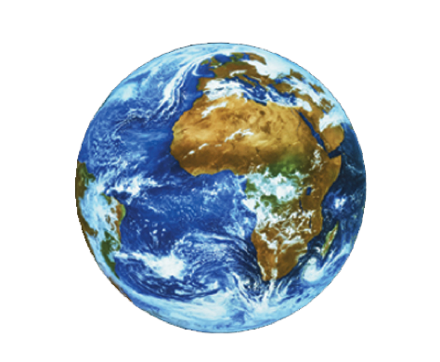
Here We Are in the Anthropocene
For better and worse
Like it or not
Ready or not
Notes:
For a long time increases in energy use didn’t matter too much because the planet was a big, robust place, compared to our small species
Our rise in energy use has suddenly, recently, and accidentally, landed in the Anthropocene – the era in which we are big and powerful compared to our fragile planet
100 years ago we couldn’t smash the planet up if we tried
50 years ago we realised we could smash it up if we did something stupid, like have a nuclear war
Now, we are in a position where we will smash it up unless we try pretty hard not to
The Anthropocene is a totally different context for humans to operate in
The structure of our societies, our values and the way we think were all developed when we were a small species on a big planet
The Anthropocene brings with it the question of how much of the way we live is still fit for purpose?
We need to find a way of reengineering what is not fit for purpose very quickly

Slide 5
A multidimensional
challenge
Climate
Food
Energy
Population
Disease
Threats
Biodiversity
Other
Pollution
Plastics
Notes:
These are some of the issues facing our planet today
Biodiversity loss
Plastic pollution
Feeding the global population
Inequality
Diet
Antibiotic resistance (2/3 of antibiotics globally are fed to animals)
Energy
This leads on into other things that we need to consider to deal with these issues
Truth and trust:
There is more complexity in the world than we have ever had to deal with, so our view of the truth needs to be clearer than ever
We must insist on truth from our leaders and the media, and question whether our information sources are worthy of our trust
Inequality
Without addressing inequality, global agreements and cooperation required to tackle climate change will not be possible
Growth
Is growth the root of all evil?
Is all growth bad?
Values
There may be some values that we must all adopt in order to make widespread changes
Human thought
Maybe we urgently need to become better at certain types of thinking

Slide 6
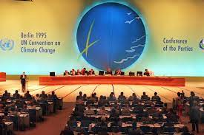
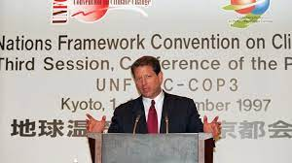
27 COPs…

Slide 7
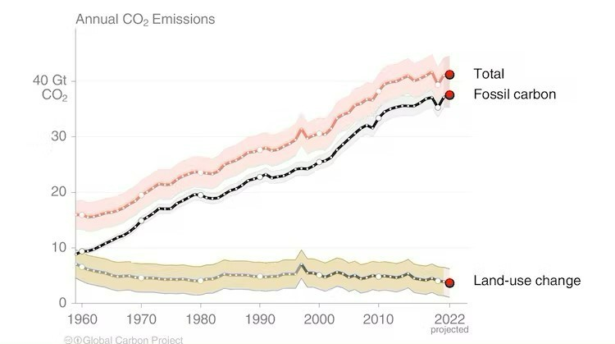
First COP
1995

Slide 8
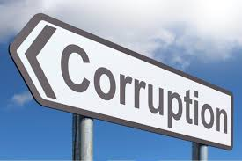
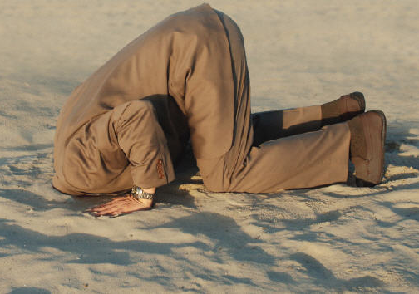
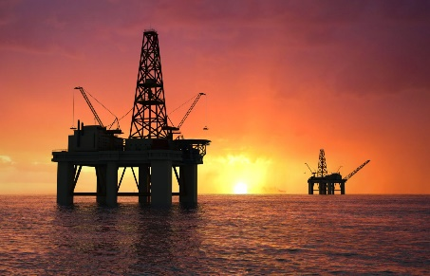
Accelerating into a polycrisis
Lobbying

Slide 9
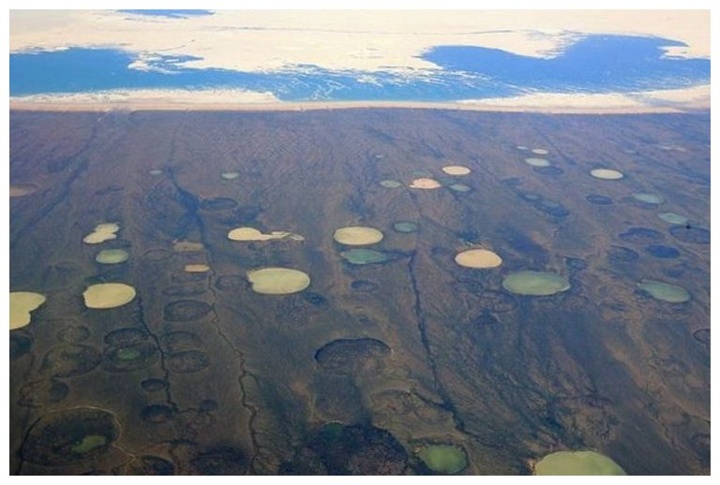
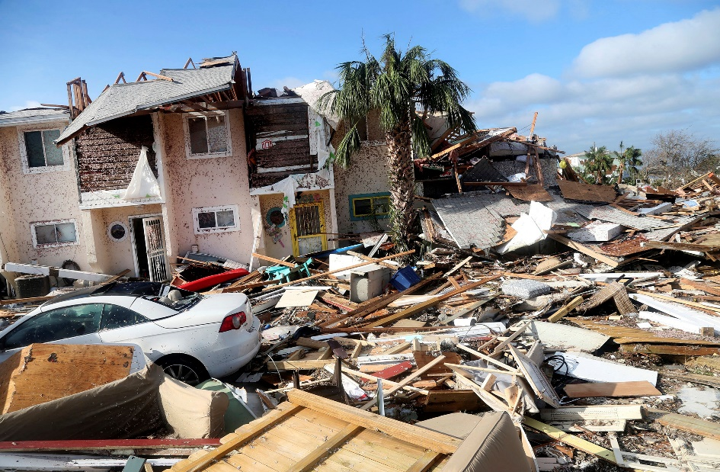
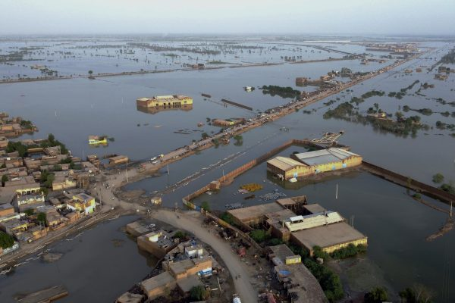
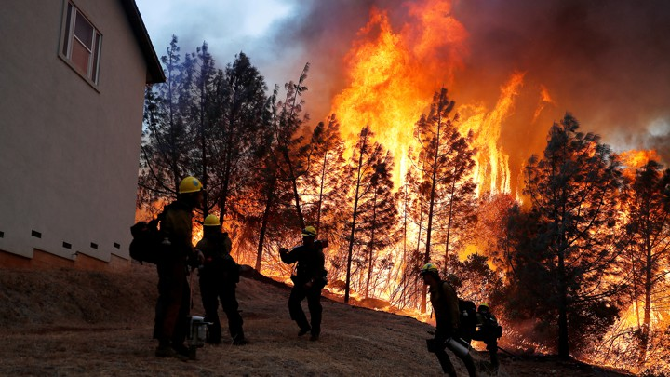
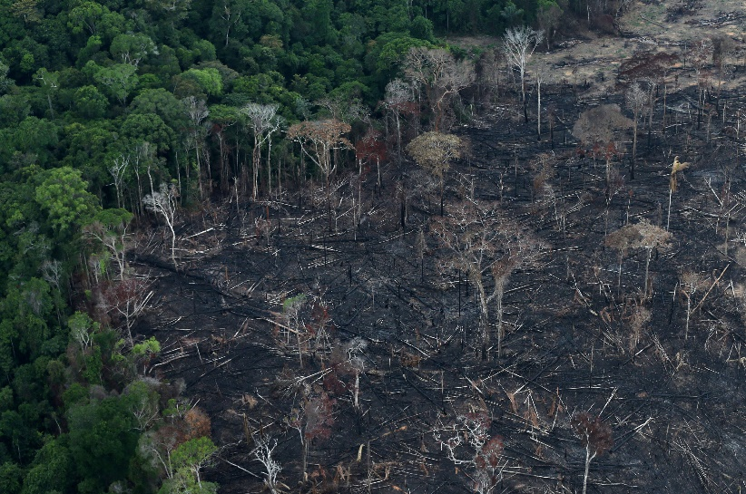
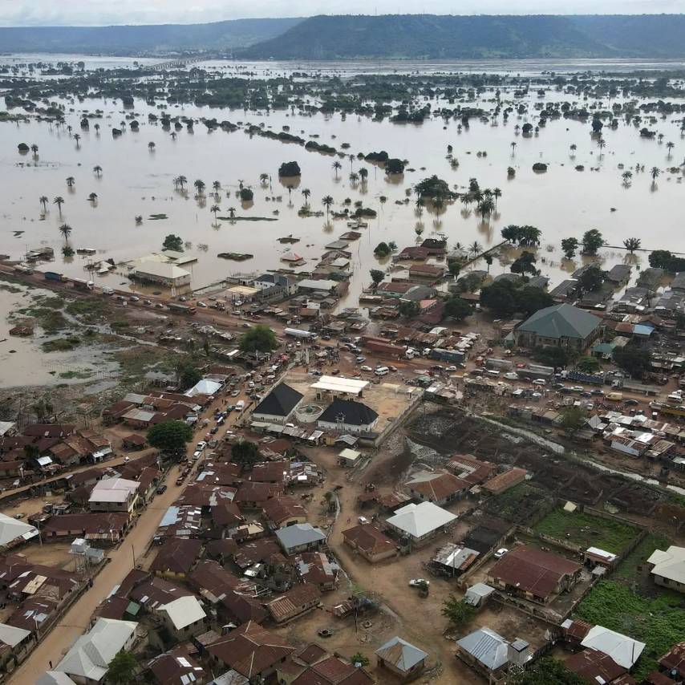
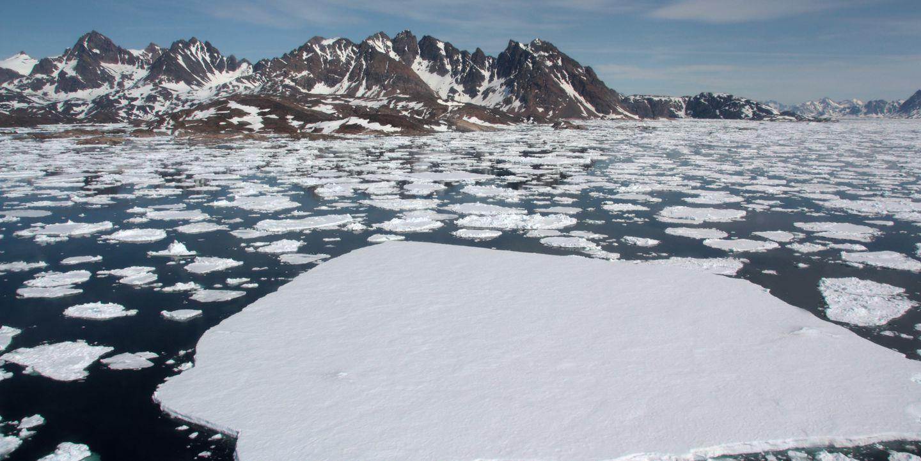
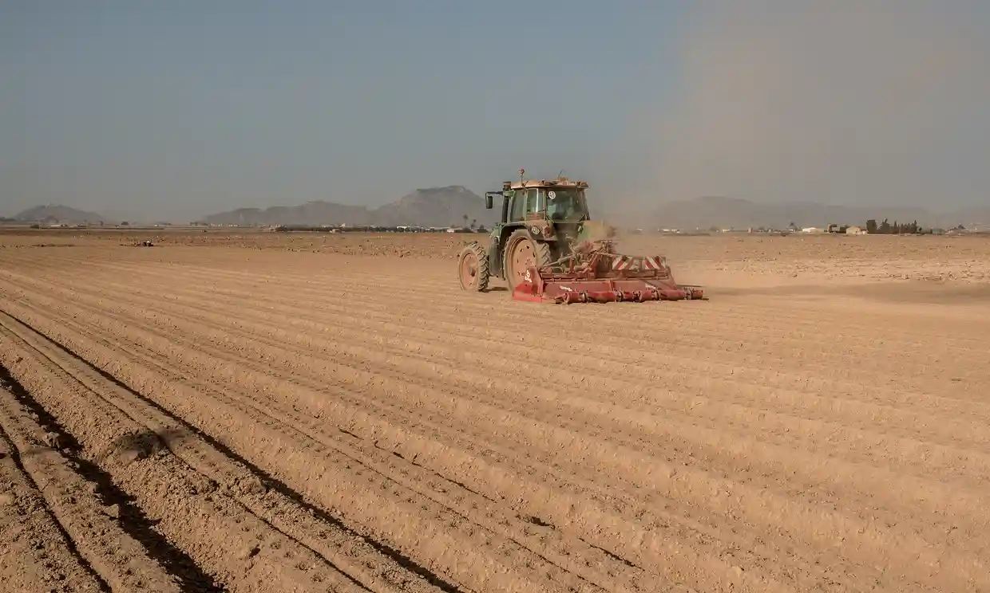
Early symptoms

Slide 10
Cascading tipping points?

Slide 11
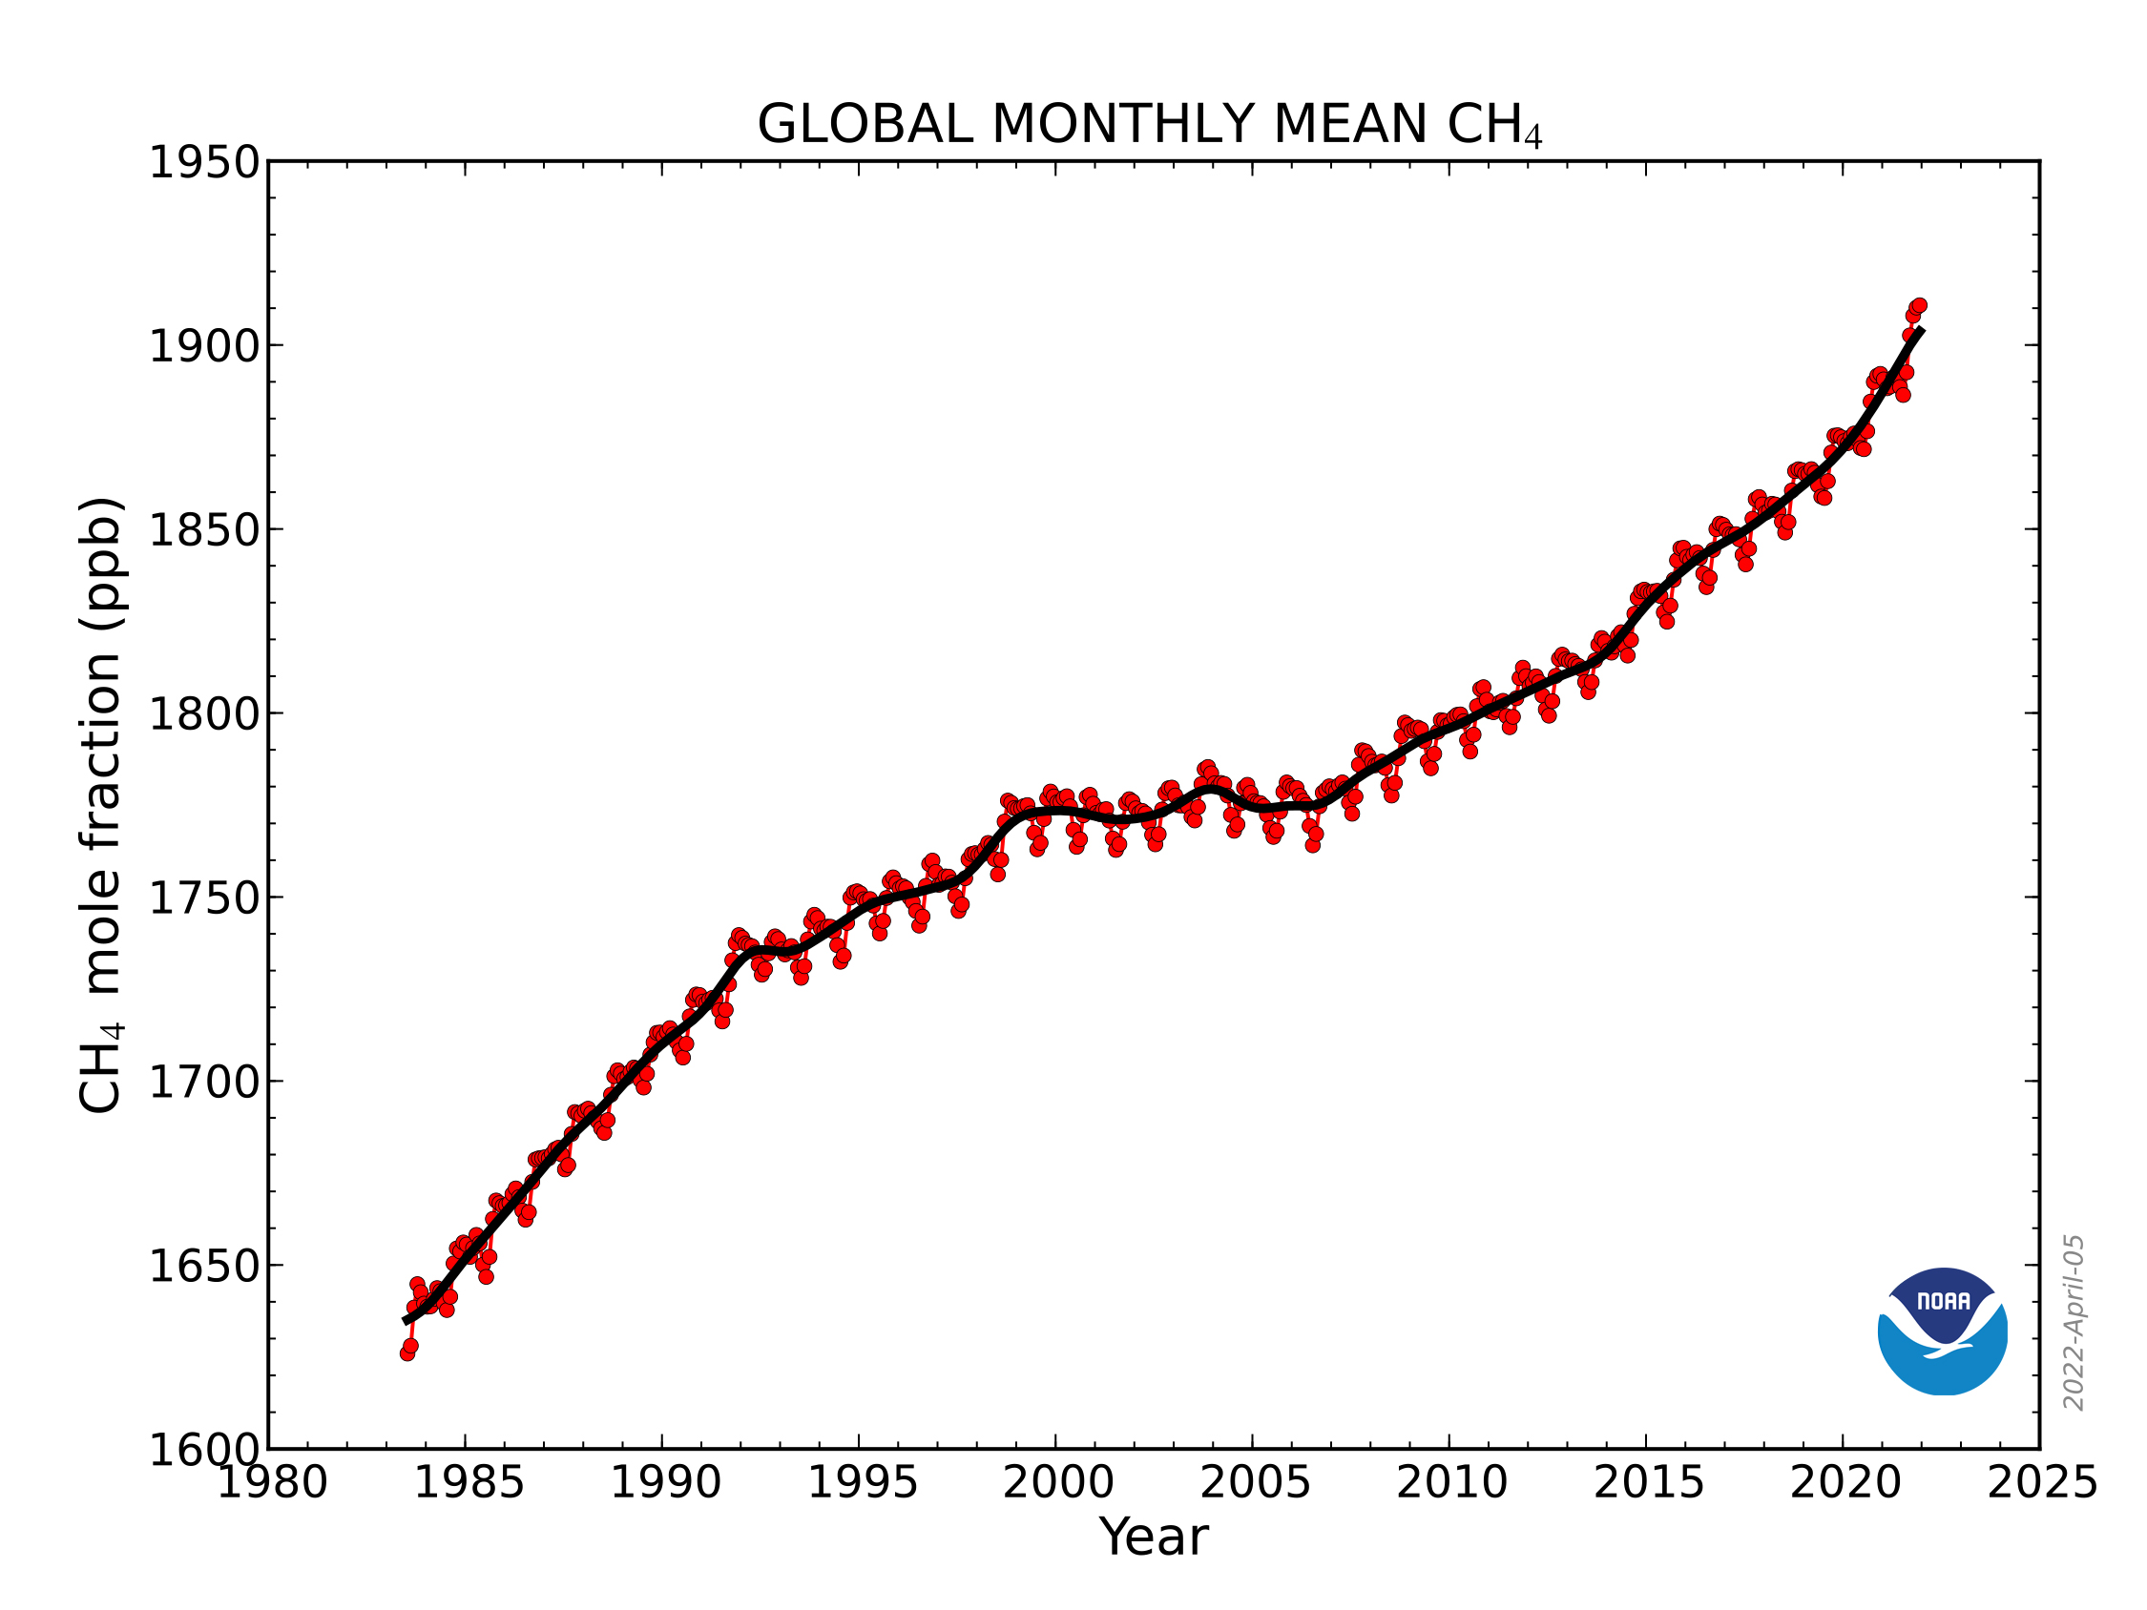
Sharply rising atmospheric methane

Slide 12
Antarctic sea ice 11% below 2022 record low
Source: NASA Earth Observatory

Slide 14
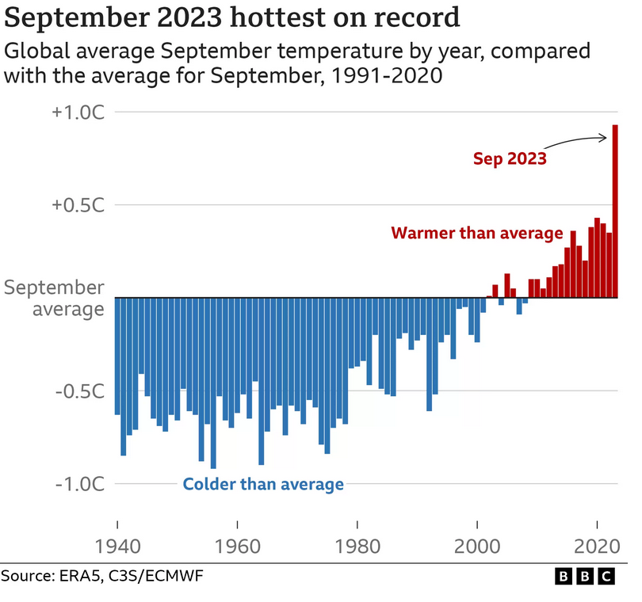

Slide 15
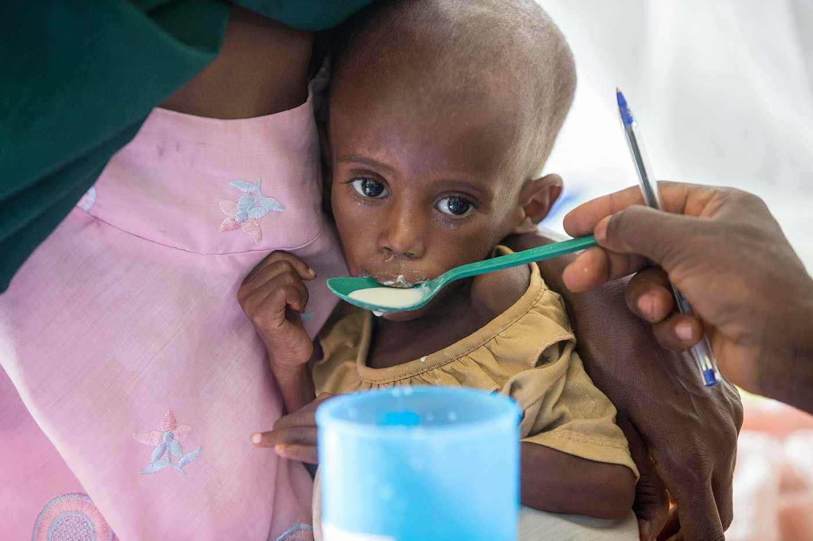
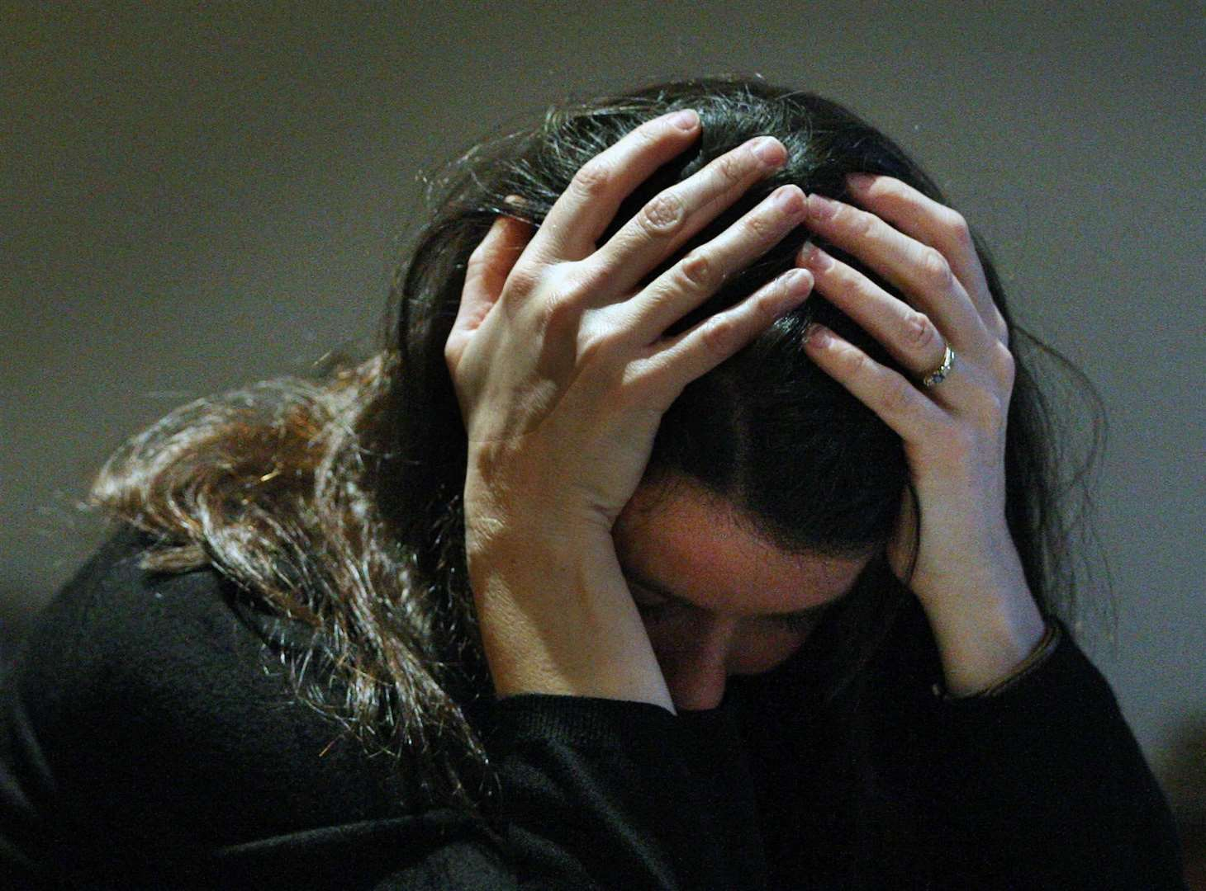
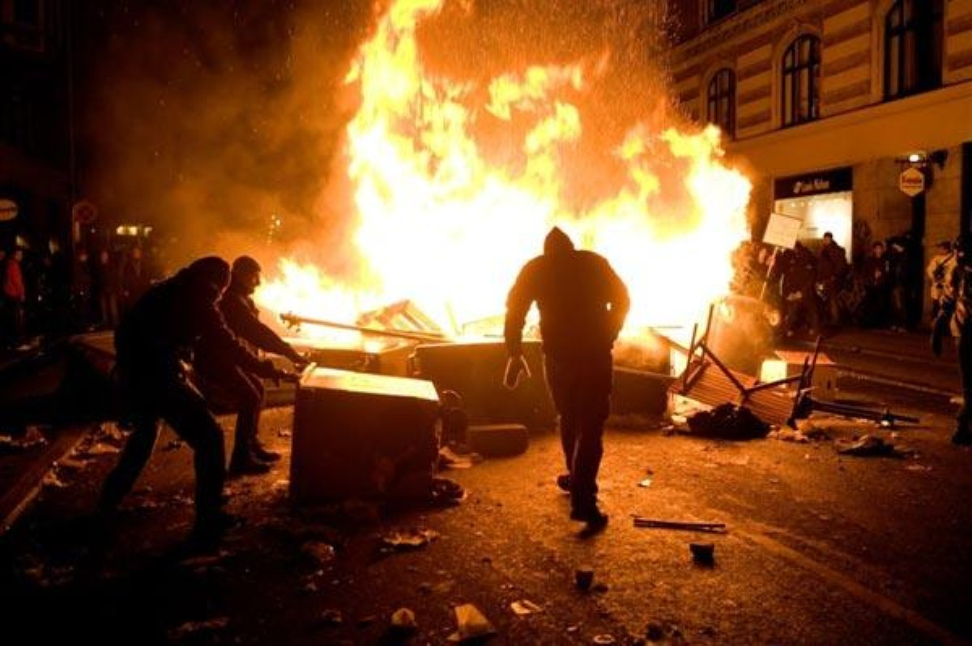
Threat multipliers
War
Famine and food security
Health and mental illness
Civil strife

Slide 16
A quick poll
In broad terms do you think my analysis is:
About right
Fundamentally underestimated
Fundamentally exaggerated?

Slide 17
“You may choose
to look the other way,
but you can never
say again that
you did not know”
William Wilberforce

Slide 18
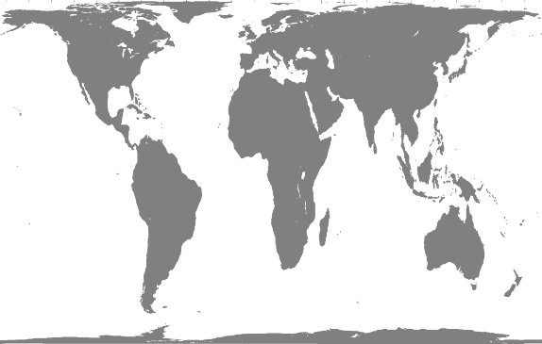
How much of the world’s land area would need to be covered in solar panels to meet today’s human energy demand?
400km
400 km
2023
0.1% = 400 km square
Notes:
If we replace our energy supply with primarily solar energy
We are only harnessing about 1/7000th of the worlds sunlight at the moment
If there was a blob of solar panels as big as the dot on the map (0.1% of the world’s surface area), it would capture our entire energy supply at the moment
Solar panels are getting cheaper

Slide 19
But If We Keep Growing Our Demand ….
2023
0.1% = 245 miles square
2123
1.1% = 802 miles square
2223
12.0% = 2625 miles square
2323
128.4% = 8594 miles square
Notes:
If we keep growing energy supply at the current rate of 2.4% per year, by 2323 the entire land area of the earth, and then some, would have to be covered in solar panels to maintain solar energy supply
This is to illustrate: we need to manage our growth in energy supply

Slide 20
Who gets the sunlight?
Notes:
Sticking with the subject of solar power, who gets the sunlight?
This map is not so optimistic for some regions (UK, Bangladesh, Holland etc.)
We cannot rely just on solar power

Slide 21
Those with fossil fuels usually also have sun
Notes:
More or less, the countries with the most to lose in terms of the fossil fuel industry have the best switchover possibilities to solar energy.
What they might lose by leaving their coal in the ground will surely be outweighed by their renewable energy abundance.

Slide 22
Who has the wind?
Notes:
Wind can become a significant part of the energy mix, although it is much more limited than solar power, and at least as temperamental. (however this graph is potentially encouraging to people in the UK).

Slide 23
Some Carbon Numbers

Slide 24
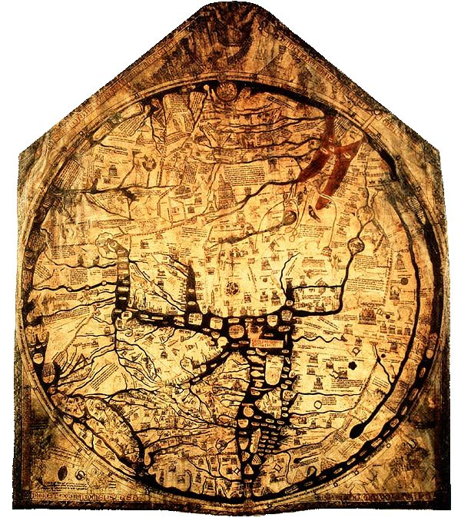
Carbon footprinting is like early map making…
All carbon footprinting is crude, but a rough estimate is better than nothing.
It’s important to understand the uncertainty. Treat carbon footprints with caution.

Slide 25
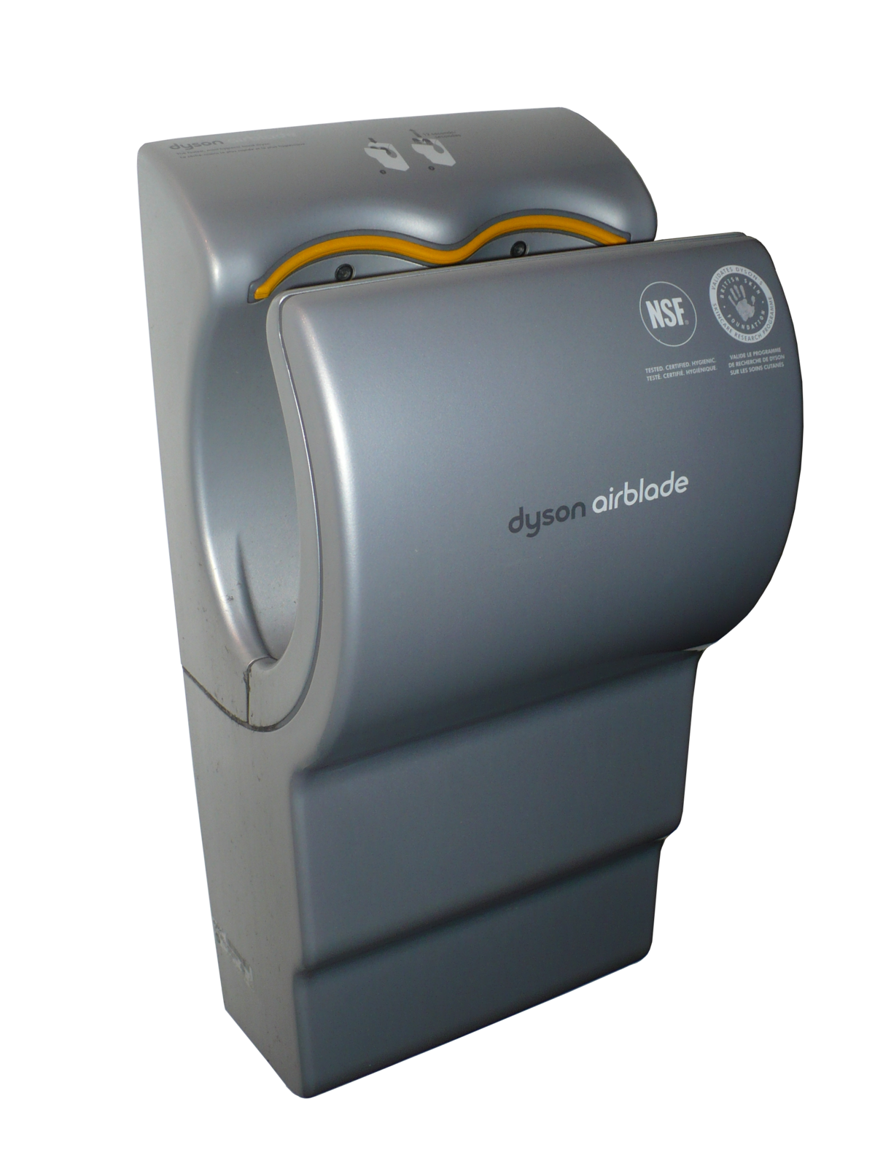
Drying your hands
10g CO₂e one paper towel
0g CO₂e letting them drip
2g CO₂e Dyson Airblade
11g CO₂e standard electric dryer

Slide 26
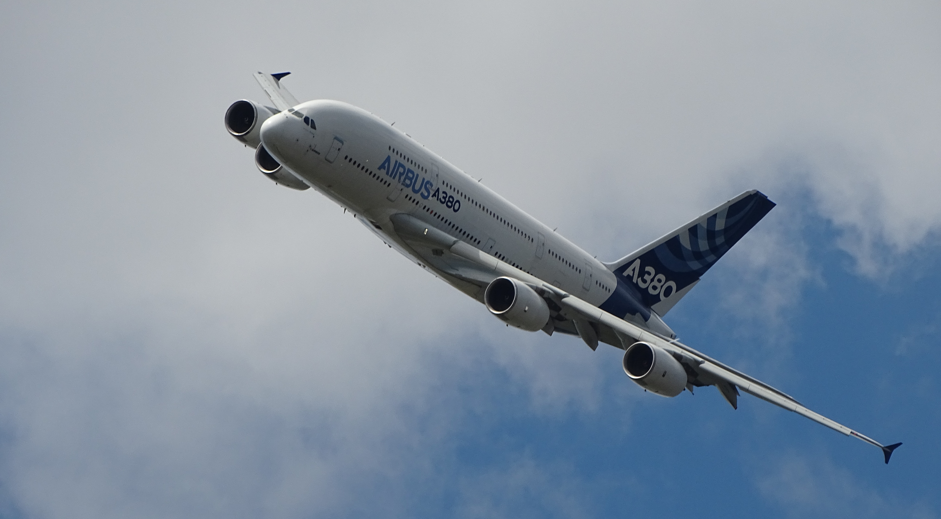
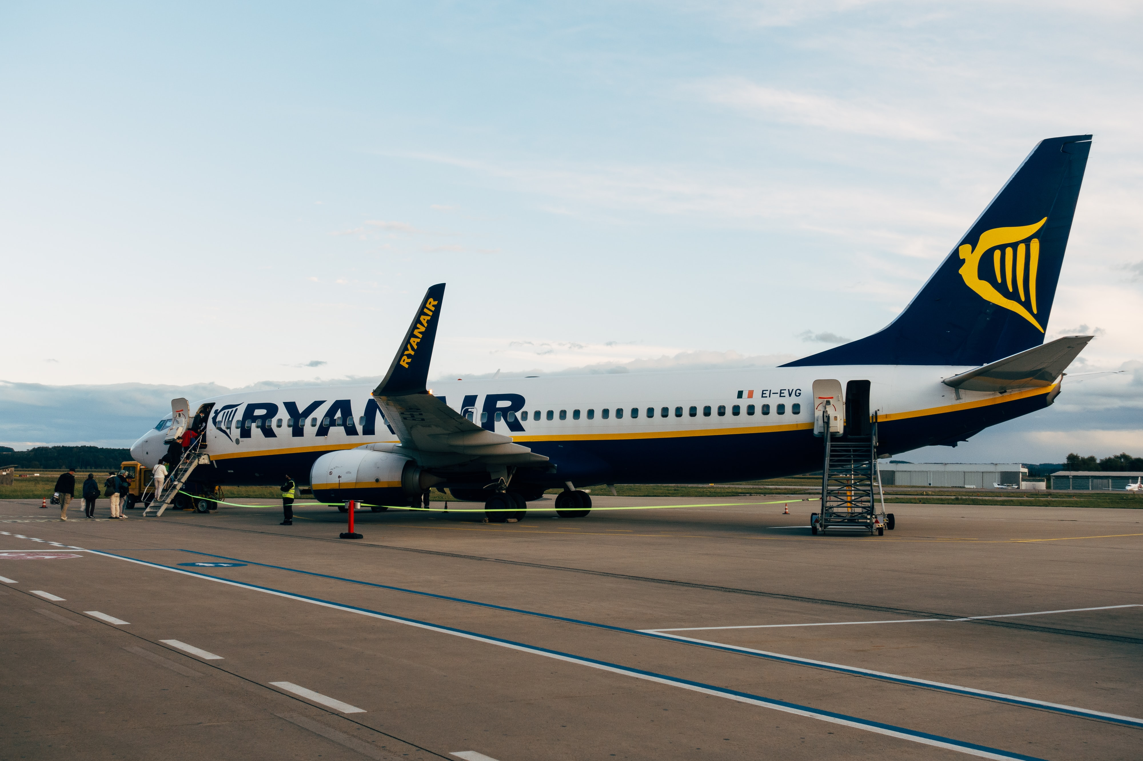
Flying
London to Hong Kong return ticket
0 CO₂e
3.5 tonnes CO₂e economy class
13.9 tonnes CO₂e first class
4.5 tonnes CO₂e premium economy
10 tonnes CO₂e business class
Photo by G-R Mottez on Unsplash
Photo by Markus Winkler on Unsplash

Slide 27
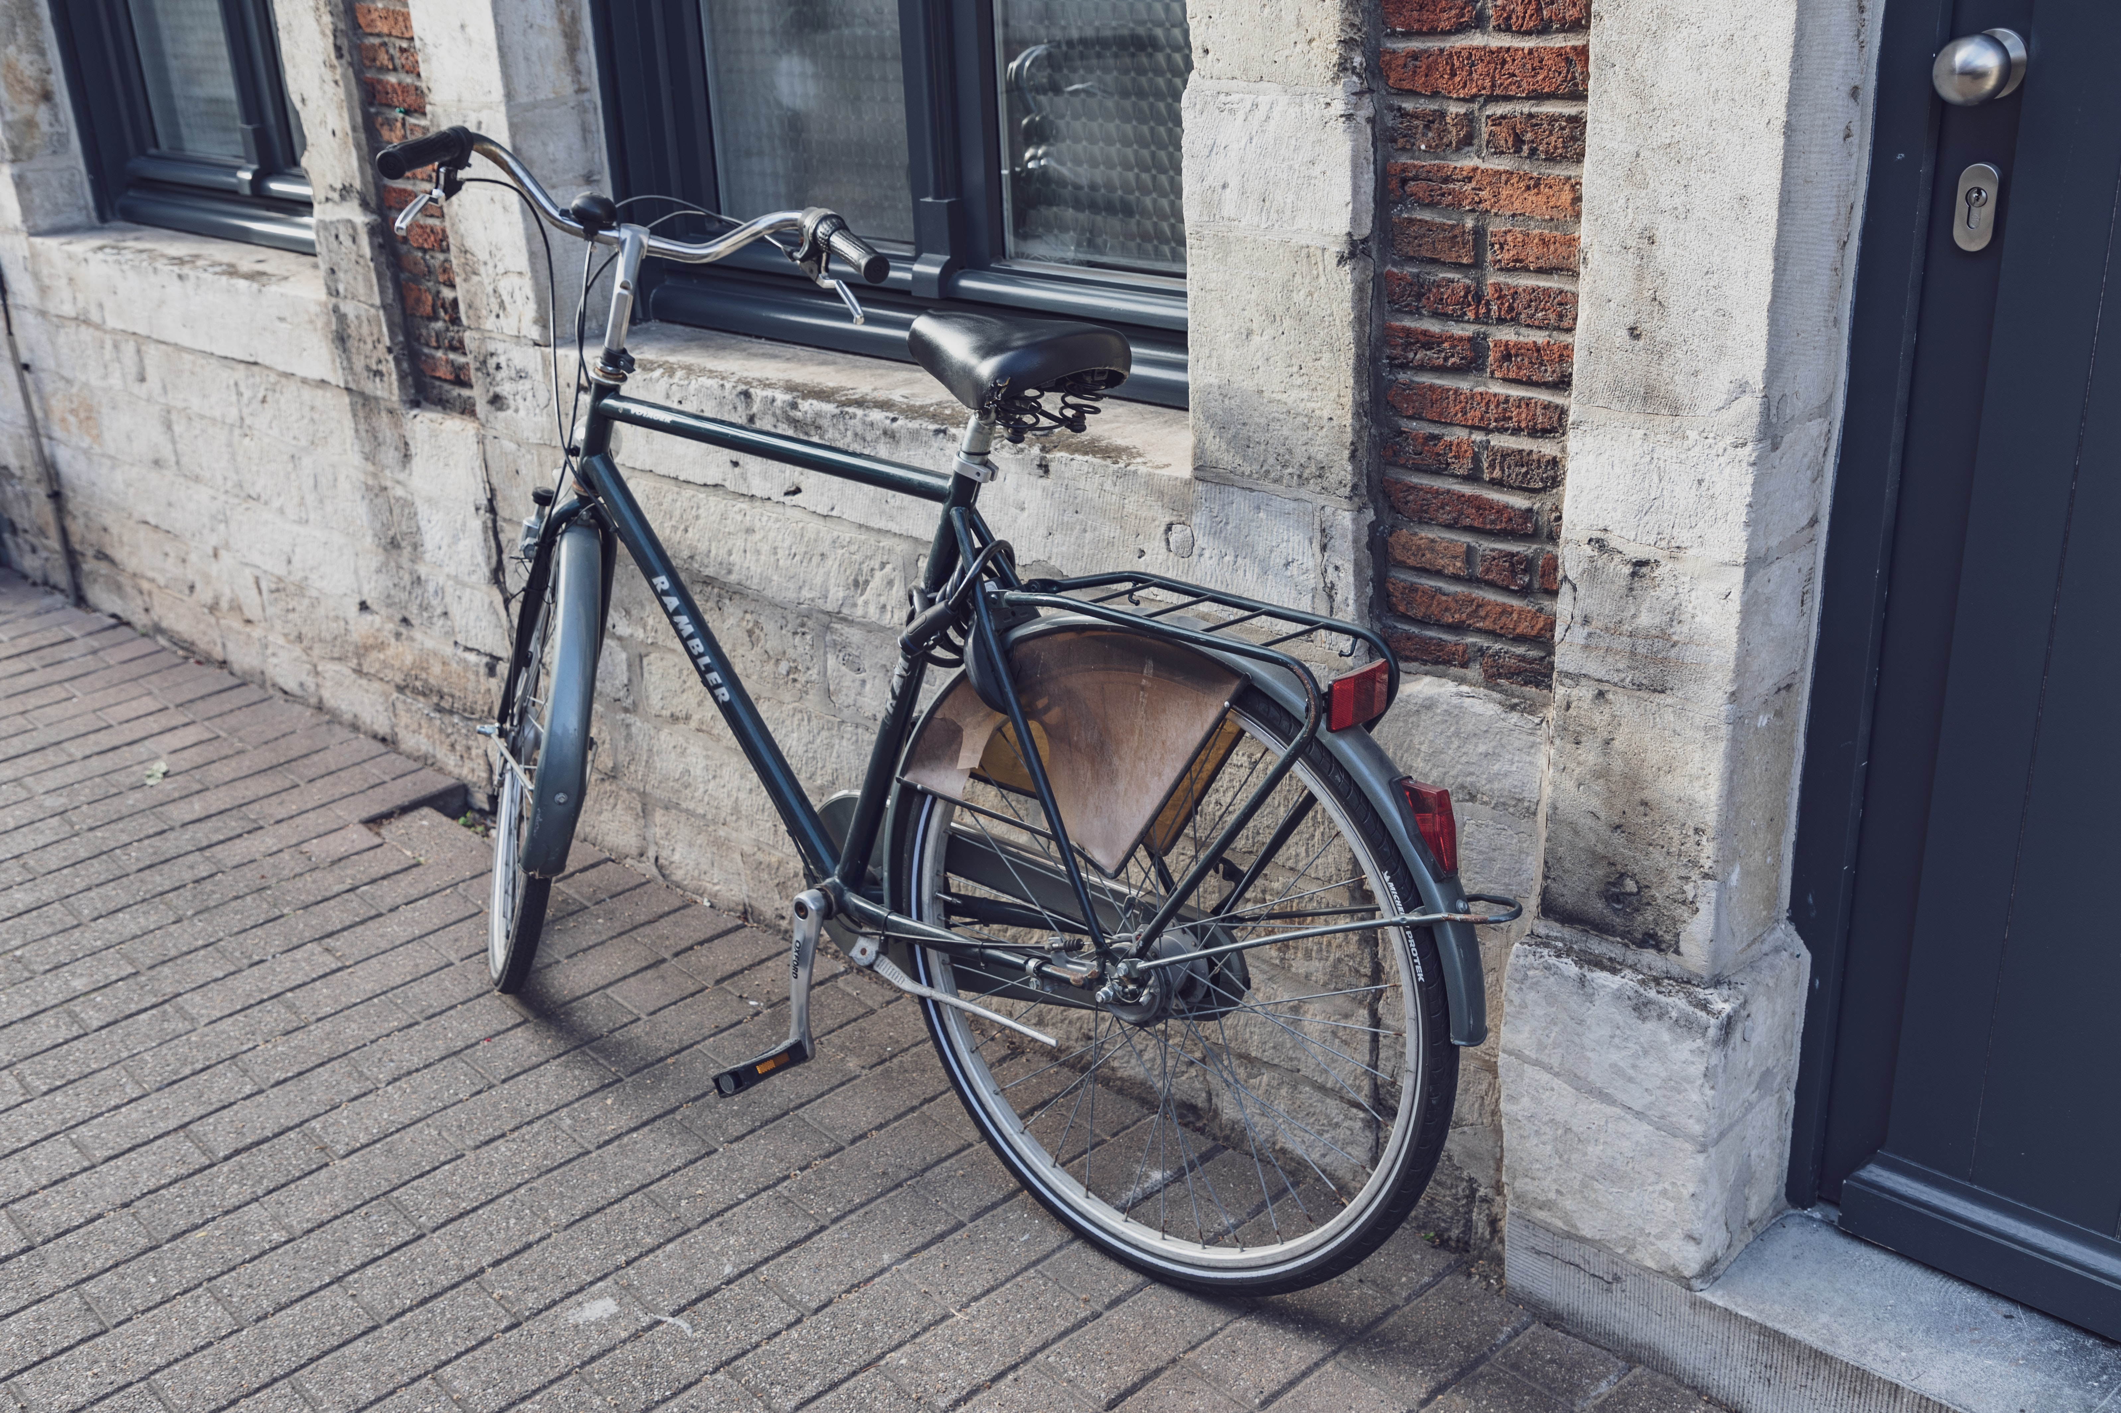
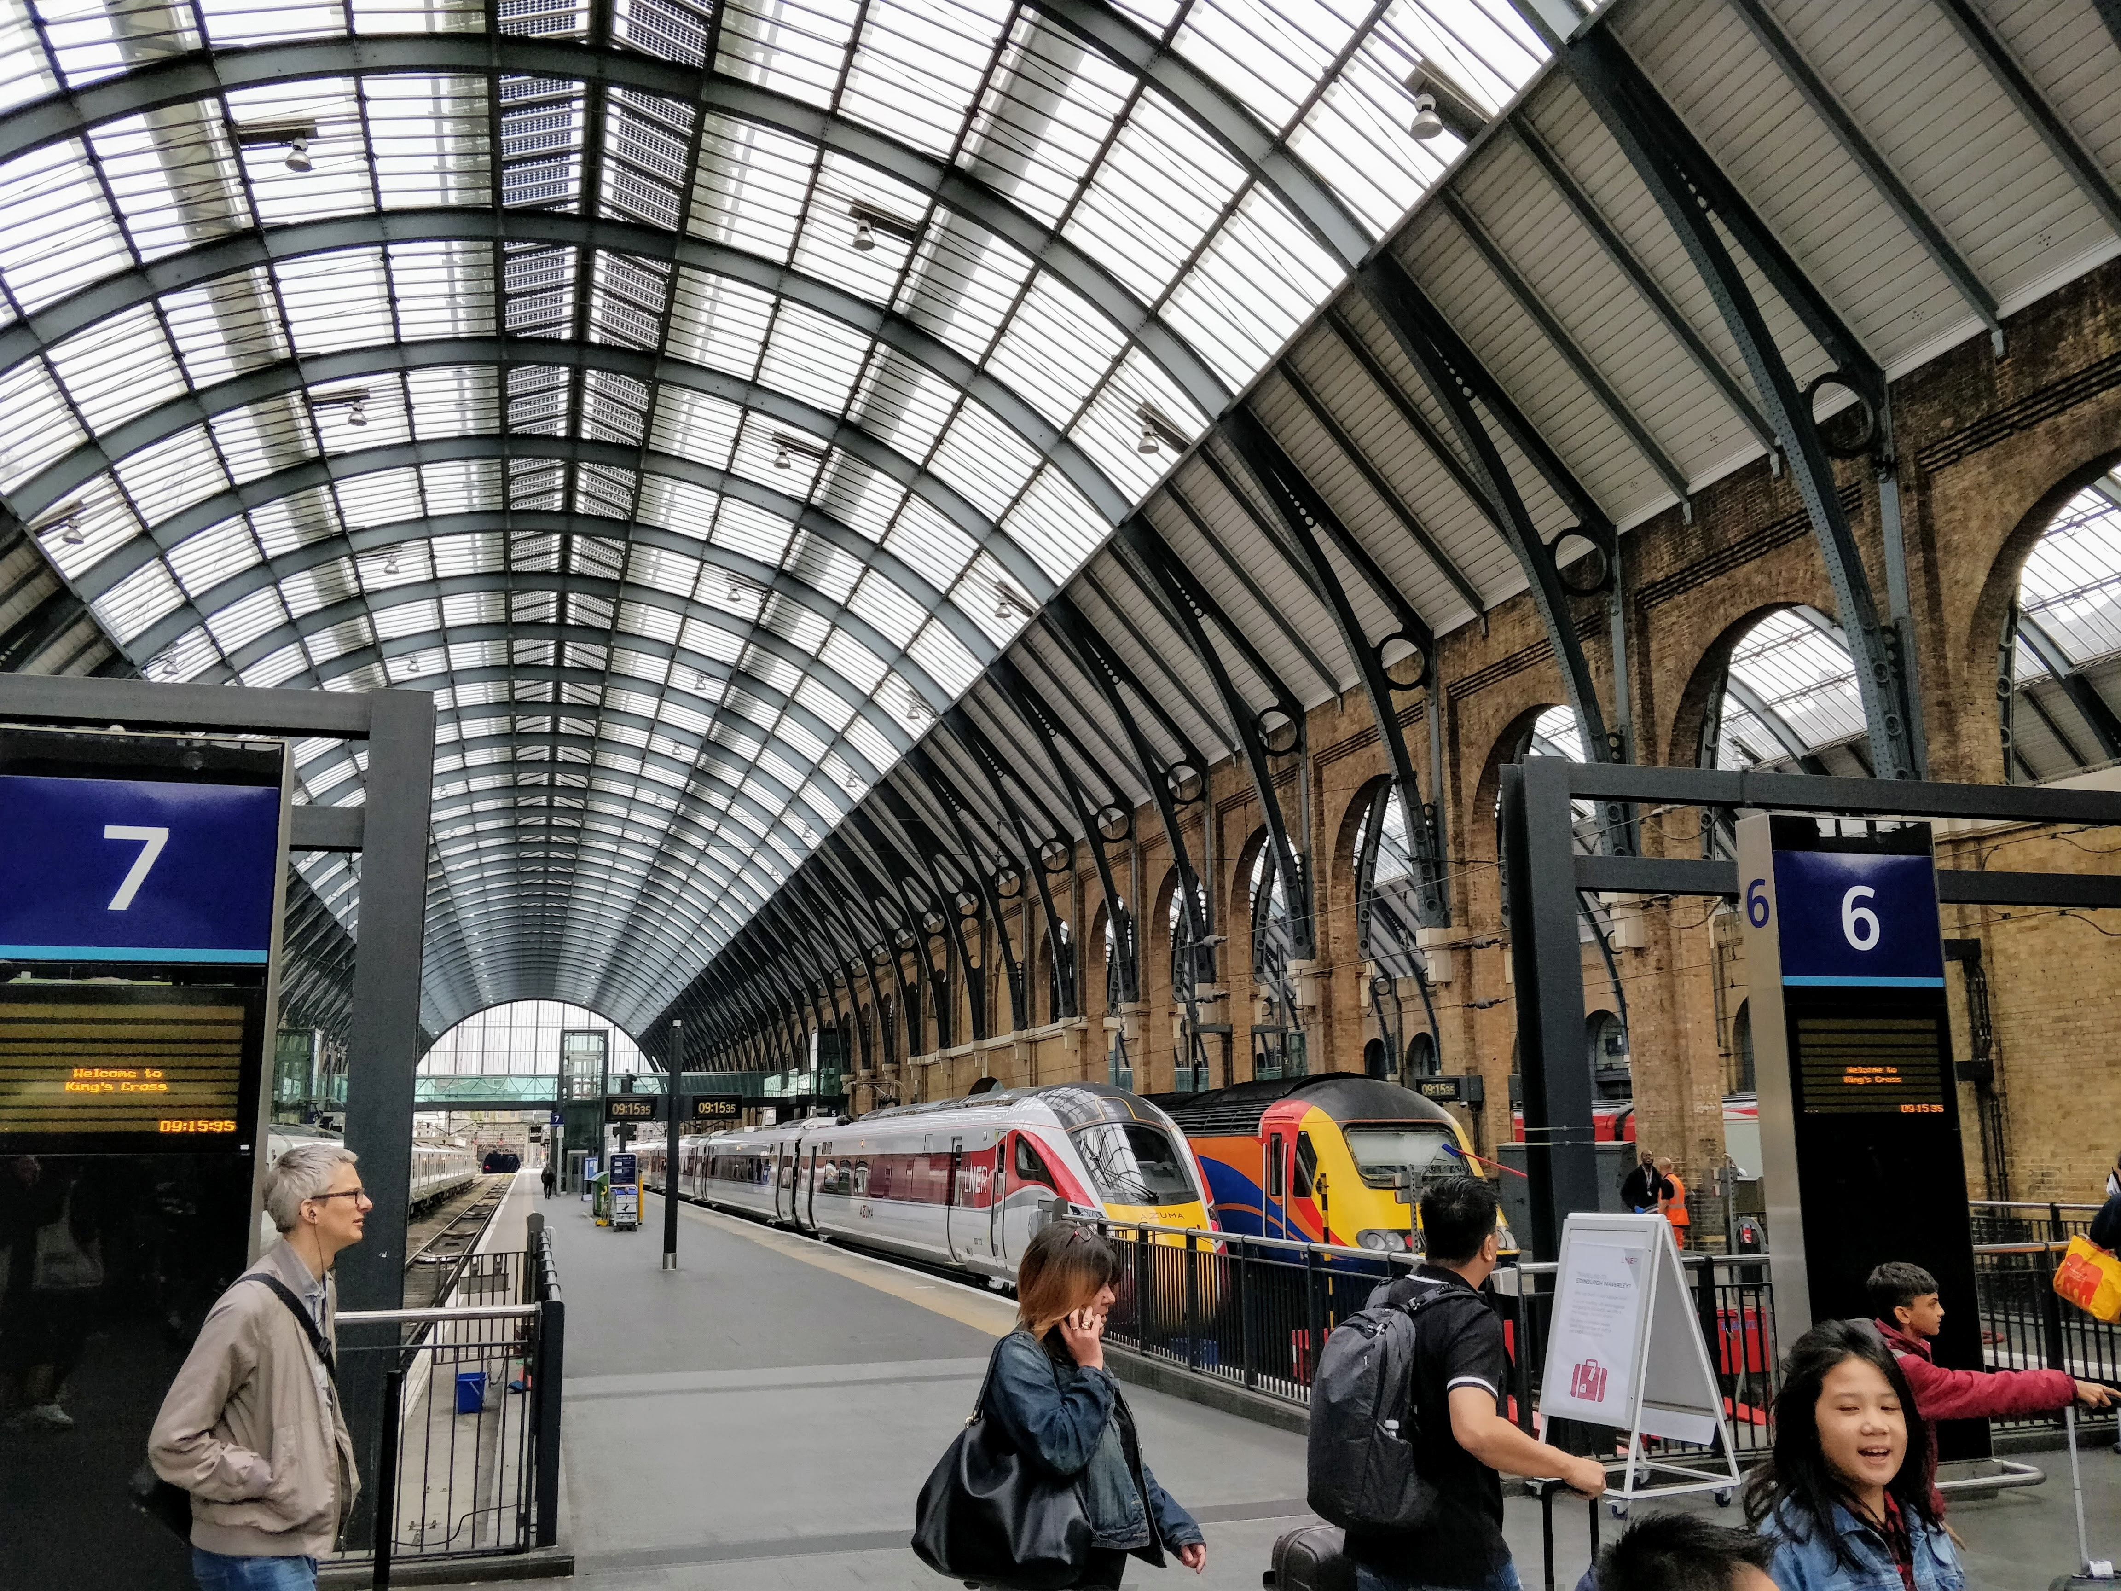
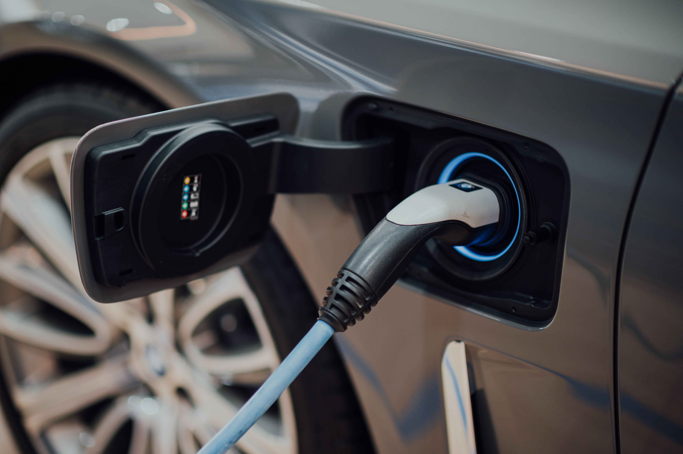
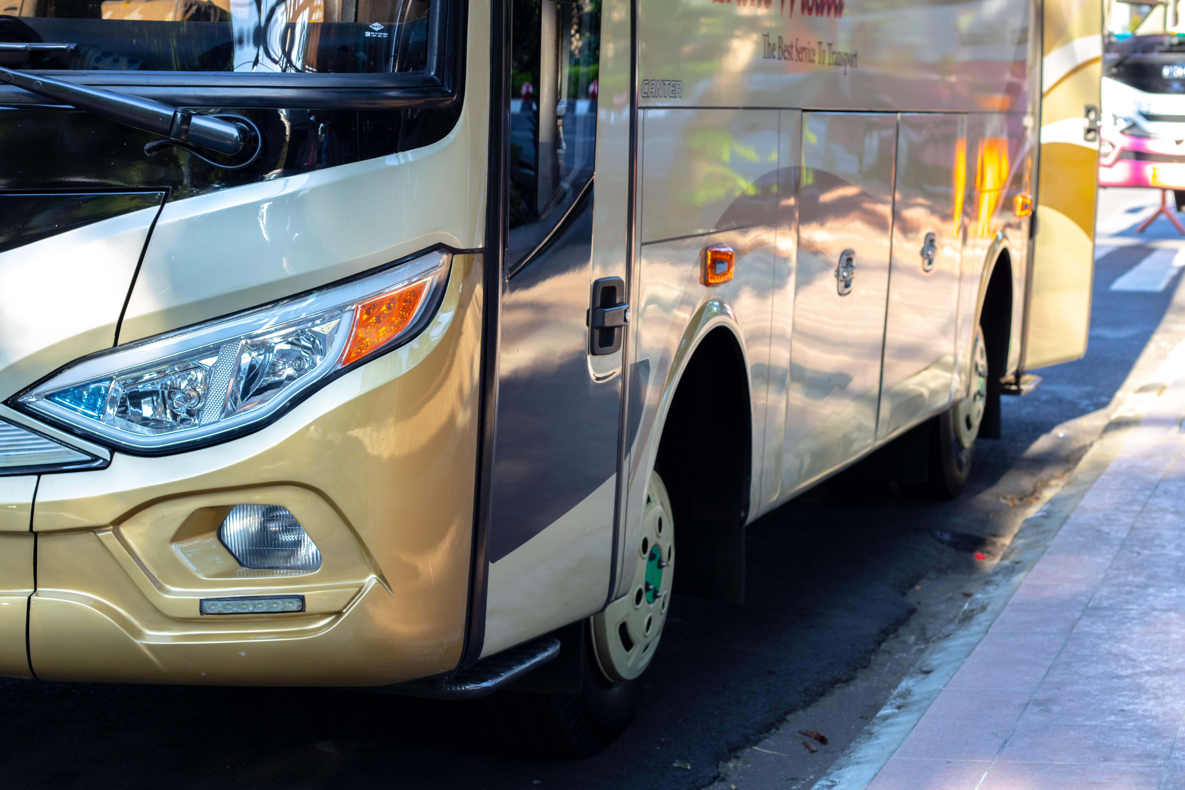
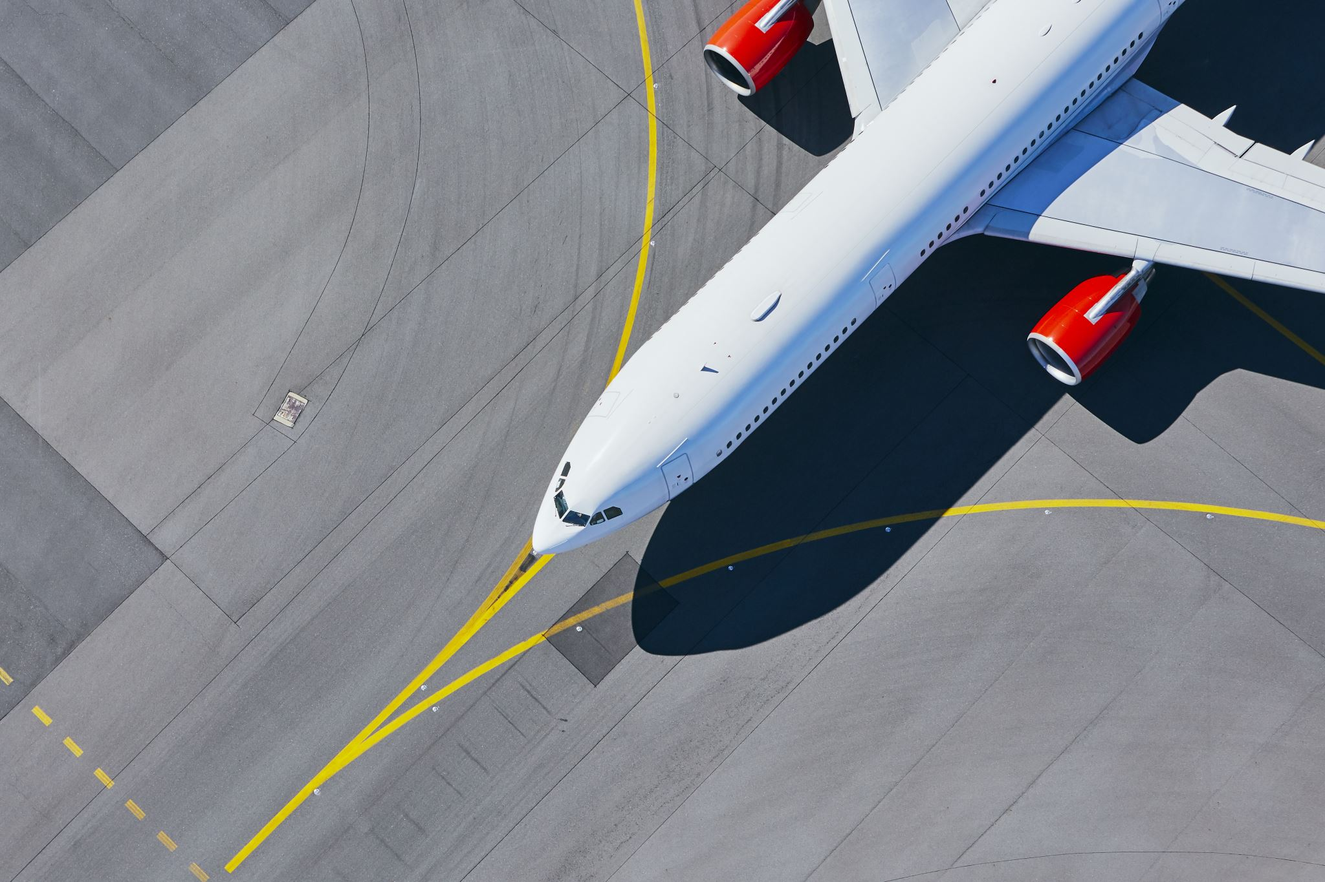
Barcelona to Madrid
4.1kg CO₂e electric bike
30kg CO₂e bike
40kg CO₂e coach
64kg CO₂e train
148kg CO₂e small electric car (driver only)
237kg CO₂e small efficient petrol car (driver only)
368kg CO₂e plane
1.02 tonnes CO₂e large SUV (driver only)
Photo by CHUTTERSNAP on Unsplash
Photo by Hobi industri on Unsplash

Slide 28
Our ‘best estimate’ of ICT’s carbon footprint in 2020: ~ 2.2 billion tonnes CO₂e*
Including all electronic communication, analysis and storage.
Not IoT
~ 3.9% of global emissions
Becoming more efficient all the time
Having increasing influence on the global economy
Impacts almost certainly rising unless boundaries are constrained to exclude emerging elements.
*(Based on Malmoldin’s estimate, with cryptocurrencies added and truncation error adjusted for. Excludes much of IoT and AI)

Slide 29
Technical Solutions to Energy and Climate

Slide 30
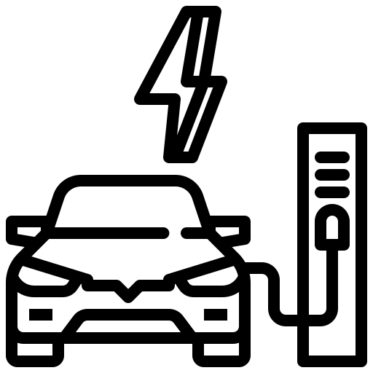
Technical Solutions to Energy and Climate
End Use
Buildings
Transport
Industry
Icons designed by Freepik.

Slide 31
Demand reduction
Technical Solutions to Energy and Climate
End Use
Buildings
Industry
Transport
Icons designed by Freepik.

Slide 32
Cut
fossil fuel
Demand reduction
Technical Solutions to Energy and Climate
Generation
Solar+ wind + other
End Use
Buildings
Industry
Transport
Icons designed by Freepik.

Slide 33
Cut
fossil fuel
Demand reduction
Technical Solutions to Energy and Climate
Generation
Solar+ wind + other
Transport, Transmission and Storage
End Use
Electricity Grid
Buildings
Industry
Transport
Icons designed by Freepik.

Slide 34
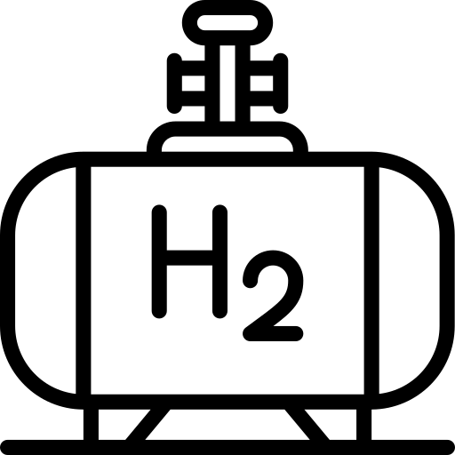
Cut
fossil fuel
Demand reduction
Technical Solutions to Energy and Climate
Generation
Solar+ wind + other
End Use
Electricity Grid
Conversion
for storage
Buildings
Storage
Industry
Underground
Electrolysis
Hydrogen
Tanks above ground
Transport
Icons designed by Freepik.

Slide 35
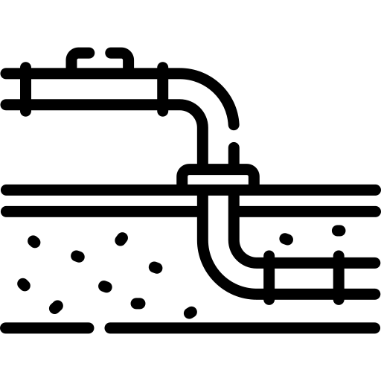
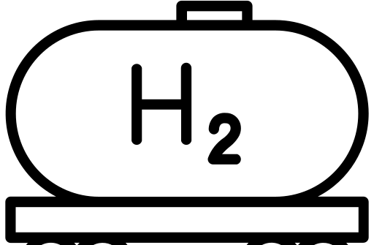
Cut
fossil fuel
Demand reduction
Technical Solutions to Energy and Climate
Generation
Solar+ wind + other
End Use
Electricity Grid
Conversion
for storage
Buildings
Storage
Transport
Industry
Underground
Pipes
Electrolysis
Hydrogen
Ships
Tanks above ground
Transport
Icons designed by Freepik.

Slide 36
Cut
fossil fuel
Demand reduction
Technical Solutions to Energy and Climate
Generation
Solar+ wind + other
End Use
Electricity Grid
Conversion
for storage
More
storage
Conversion
for end use
Buildings
Storage
Transport
Industry
Underground
Pipes
Underground
Electrolysis
Hydrogen
Fuel cells
Ships
Tanks above ground
Tanks above ground
Transport
Icons designed by Freepik.

Slide 37
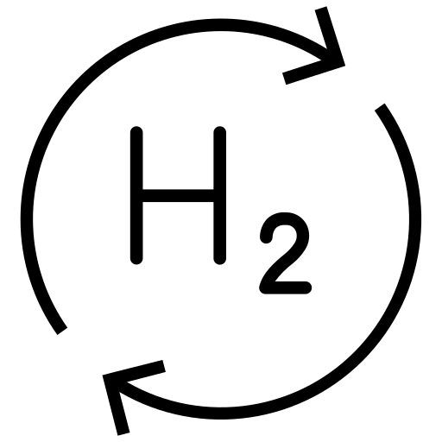
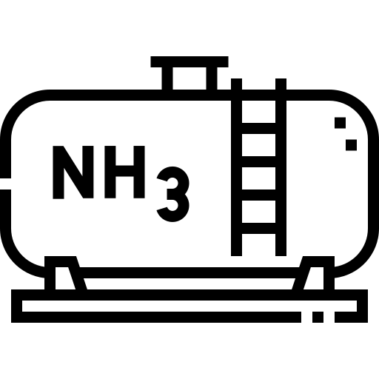
Cut
fossil fuel
Demand reduction
Technical Solutions to Energy and Climate
Generation
Solar+ wind + other
End Use
Electricity Grid
Conversion
for storage
More
storage
Conversion
for end use
Buildings
Storage
Transport
Industry
Underground
Pipes
Underground
Electrolysis
Hydrogen
Fuel cells
Ships
Tanks above ground
Tanks above ground
Transport
Ammonia
Icons designed by Freepik.

Slide 38
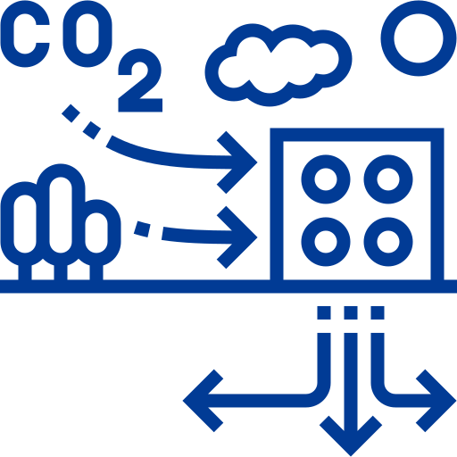
Cut
fossil fuel
Demand reduction
Technical Solutions to Energy and Climate
Generation
Solar+ wind + other
End Use
Electricity Grid
Conversion
for storage
More
storage
Conversion
for end use
Buildings
Storage
Transport
Industry
Underground
Pipes
Underground
Electrolysis
Hydrogen
Fuel cells
Ships
Carbon removal
Tanks above ground
Tanks above ground
Transport
DACCS
Ammonia
Icons designed by Freepik.

Slide 39
ICT and global climate dynamics
Enabling global efficiency
Communication
Research
Logistics
Process management
Global emissions continue to rise despite or because of ICT
Jevons paradox will apply until carbon is constrained
BUT with a carbon constraint ICT will provide essential efficiency
Rising ICT Efficiency
New Applications. E.g.:
Video calls and conferences
Distributive ledger
IoT
AI
Steeply rising role in society
Rising ICT emissions

Slide 40
ICT and global climate dynamics
The ICT industry will continue to grow very fast
ICT must be as efficient as possible
If we cut the fossil fuel, efficiency from ICT will have an even bigger role –especially the most energy efficient ICT
ICT brings efficiency and growth to the world
ICT will only help us if we also leave the fossil fuel in the ground

Slide 41
What will it take
to solve these
technically
solvable
challenges?
Climate
Food
Energy
Population
Disease
Threats
Biodiversity
Other
Pollution
Plastics
Notes:
These are some of the issues facing our planet today
Biodiversity loss
Plastic pollution
Feeding the global population
Inequality
Diet
Antibiotic resistance (2/3 of antibiotics globally are fed to animals)
Energy
This leads on into other things that we need to consider to deal with these issues
Truth and trust:
There is more complexity in the world than we have ever had to deal with, so our view of the truth needs to be clearer than ever
We must insist on truth from our leaders and the media, and question whether our information sources are worthy of our trust
Inequality
Without addressing inequality, global agreements and cooperation required to tackle climate change will not be possible
Growth
Is growth the root of all evil?
Is all growth bad?
Values
There may be some values that we must all adopt in order to make widespread changes
Human thought
Maybe we urgently need to become better at certain types of thinking

Slide 42
What will it take
to solve these
technically
solvable
challenges?
Climate
Food
Economics
Energy
Politics
Business
Population
Media
Growth
Disease
Threats
Education
Investment
Biodiversity
Inequality
Technology
Other
Pollution
Plastics
Notes:
These are some of the issues facing our planet today
Biodiversity loss
Plastic pollution
Feeding the global population
Inequality
Diet
Antibiotic resistance (2/3 of antibiotics globally are fed to animals)
Energy
This leads on into other things that we need to consider to deal with these issues
Truth and trust:
There is more complexity in the world than we have ever had to deal with, so our view of the truth needs to be clearer than ever
We must insist on truth from our leaders and the media, and question whether our information sources are worthy of our trust
Inequality
Without addressing inequality, global agreements and cooperation required to tackle climate change will not be possible
Growth
Is growth the root of all evil?
Is all growth bad?
Values
There may be some values that we must all adopt in order to make widespread changes
Human thought
Maybe we urgently need to become better at certain types of thinking

Slide 43
The core of the
polycrisis
onion
Climate
Food
Energy
Economics
Politics
Business
Population
Media
Values
Disease
Threats
Growth
Education
Biodiversity
Investment
Inequality
Technology
Other
Pollution
Plastics
Notes:
These are some of the issues facing our planet today
Biodiversity loss
Plastic pollution
Feeding the global population
Inequality
Diet
Antibiotic resistance (2/3 of antibiotics globally are fed to animals)
Energy
This leads on into other things that we need to consider to deal with these issues
Truth and trust:
There is more complexity in the world than we have ever had to deal with, so our view of the truth needs to be clearer than ever
We must insist on truth from our leaders and the media, and question whether our information sources are worthy of our trust
Inequality
Without addressing inequality, global agreements and cooperation required to tackle climate change will not be possible
Growth
Is growth the root of all evil?
Is all growth bad?
Values
There may be some values that we must all adopt in order to make widespread changes
Human thought
Maybe we urgently need to become better at certain types of thinking

Slide 44
Three values we can no longer live without
Respect All People
Respect The Truth
Respect The Environment

Slide 45
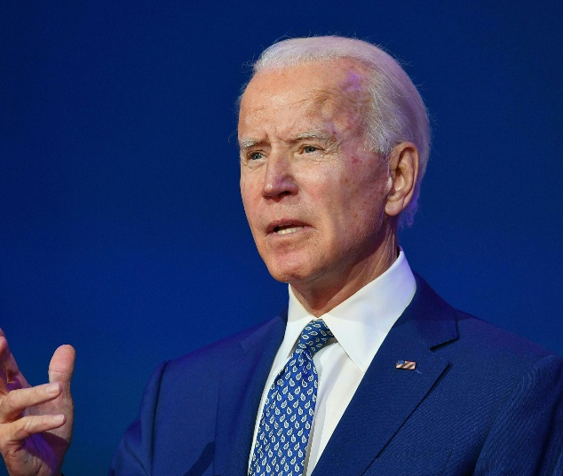
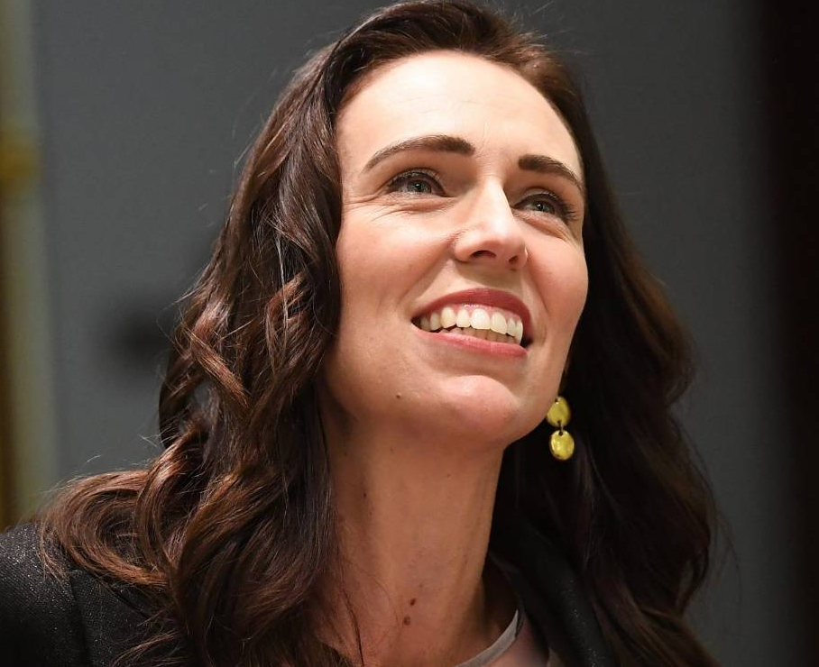
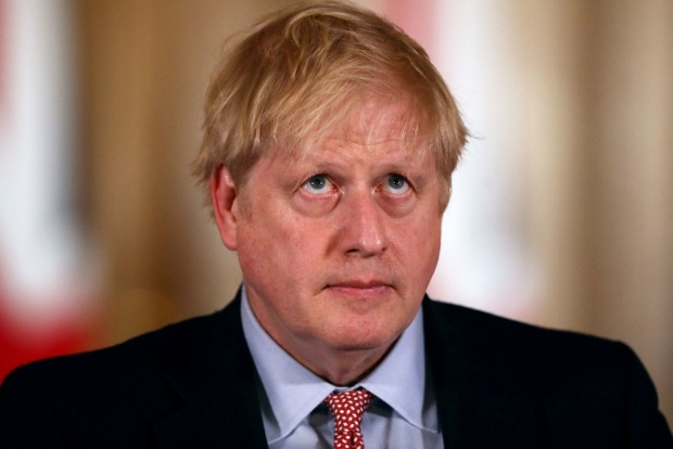
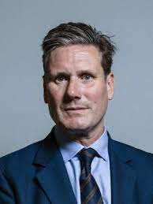
Truth and Trust
Notes:
In the age of misinformation we need to adjust our thinking skills to raise our defences against fake news
Who can we trust to tell the truth?

Slide 46
When it’s all so global, what can any of us do?
Notes:
The climate emergency is a global challenge that demands a global solution – and it is easy to feel that our own individual action is of no consequence.
It’s easy, too, to fall for the line that is often spun by politicans opposed to taking climate action – that ‘sacrifices’ made by the UK make no difference, as our CO2 emissions are tiny compared to China or the USA.
But that’s not a reasonable response.
The UK is responsible for one per cent of global emissions, and cutting those in half, and driving to net zero, has a real impact, both of itself and as a global pathway.
And each one of us – as individuals – can be a meaningful force for change, both by cutting our personal carbon and exerting pressure on our workplaces and schools, our councils and governments, and on companies and corporations.

Slide 47
When it’s all so global, what can any of us do?
How can I help to create
the conditions under which humanity can undergo
the systemic change
it so urgently needs?
Notes:
The climate emergency is a global challenge that demands a global solution – and it is easy to feel that our own individual action is of no consequence.
It’s easy, too, to fall for the line that is often spun by politicans opposed to taking climate action – that ‘sacrifices’ made by the UK make no difference, as our CO2 emissions are tiny compared to China or the USA.
But that’s not a reasonable response.
The UK is responsible for one per cent of global emissions, and cutting those in half, and driving to net zero, has a real impact, both of itself and as a global pathway.
And each one of us – as individuals – can be a meaningful force for change, both by cutting our personal carbon and exerting pressure on our workplaces and schools, our councils and governments, and on companies and corporations.

Slide 48
What might we aim for?
Notes:
We need to imagine our future
BETTER life

Slide 49
A race between tipping points

Slide 50
Thank you for listening
Mike Berners-Lee
mike@sw-consulting.co.uk

